Slide 1
SCANTRUST
QR SAFETY CHECKER
USER INTERFACE
POWERED BY GOOGLE

Slide 2
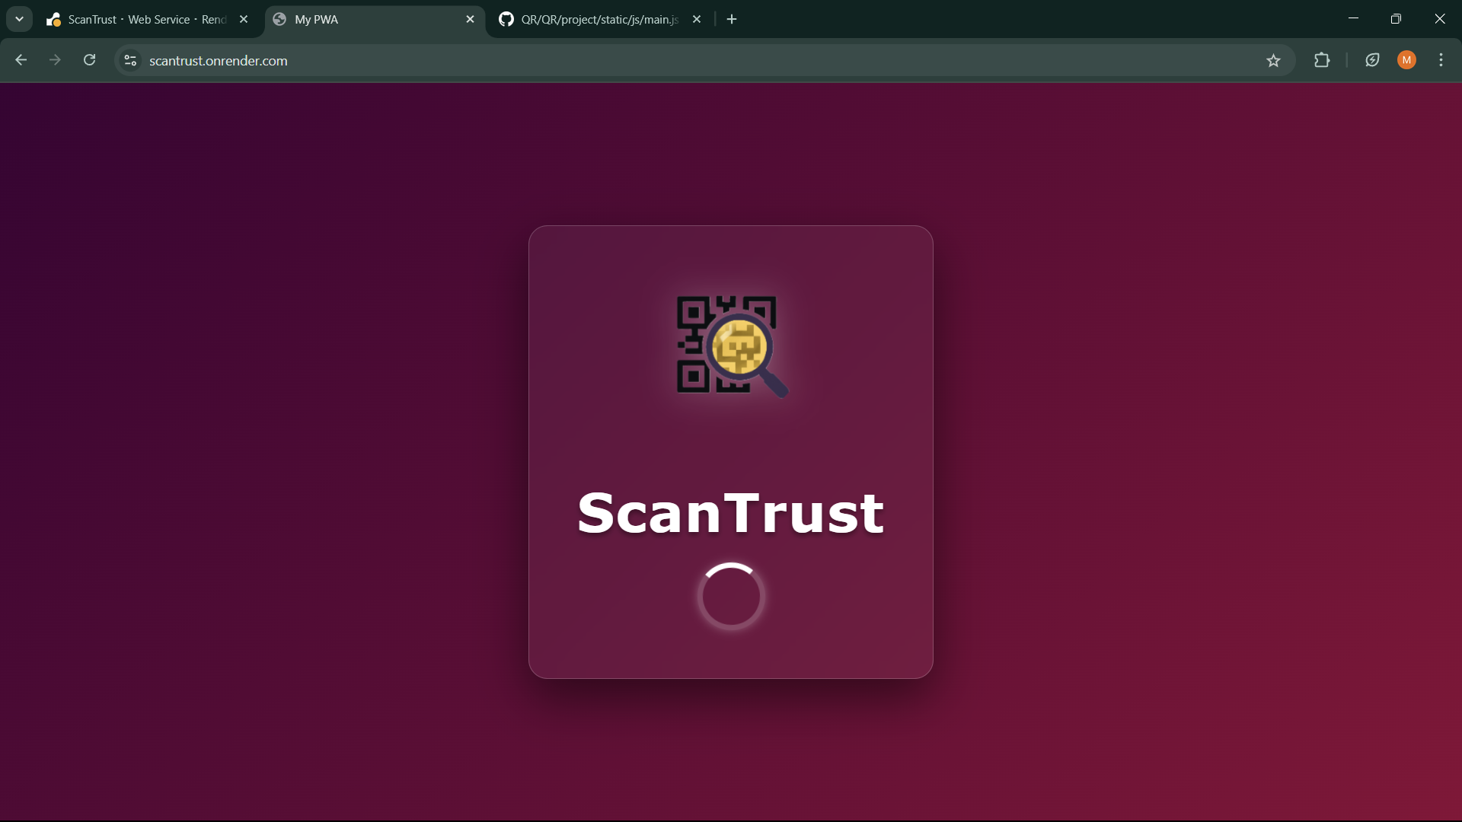

Slide 3
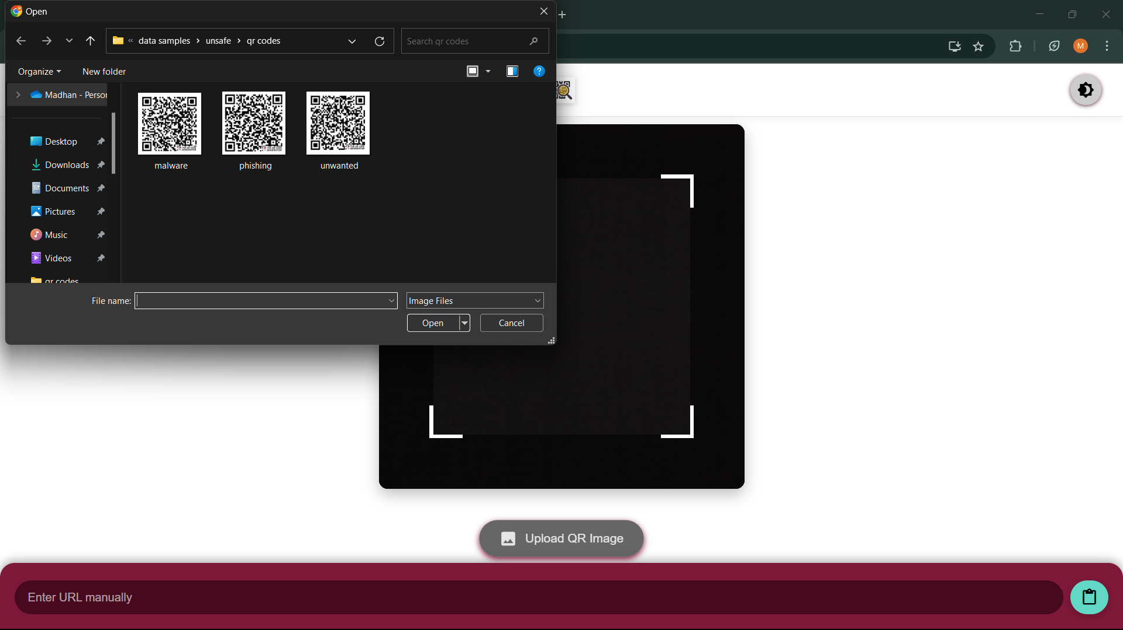

Slide 4
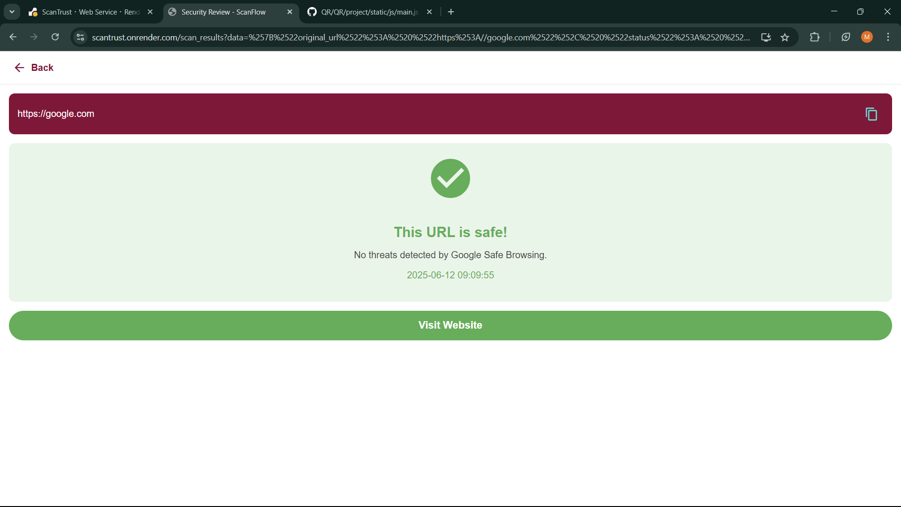

Slide 5
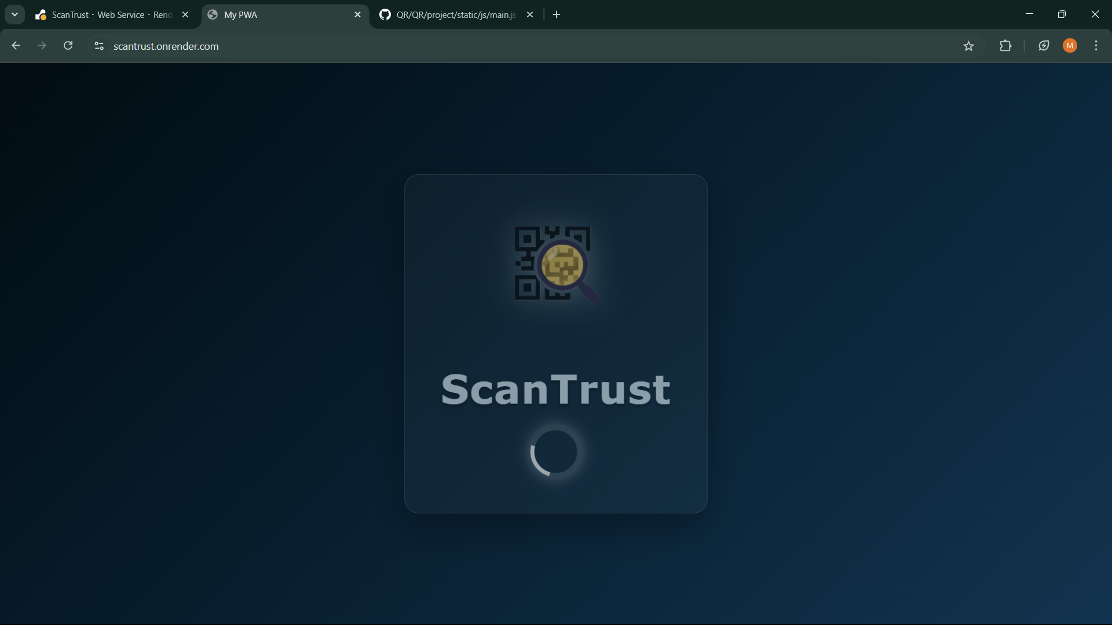

Slide 6
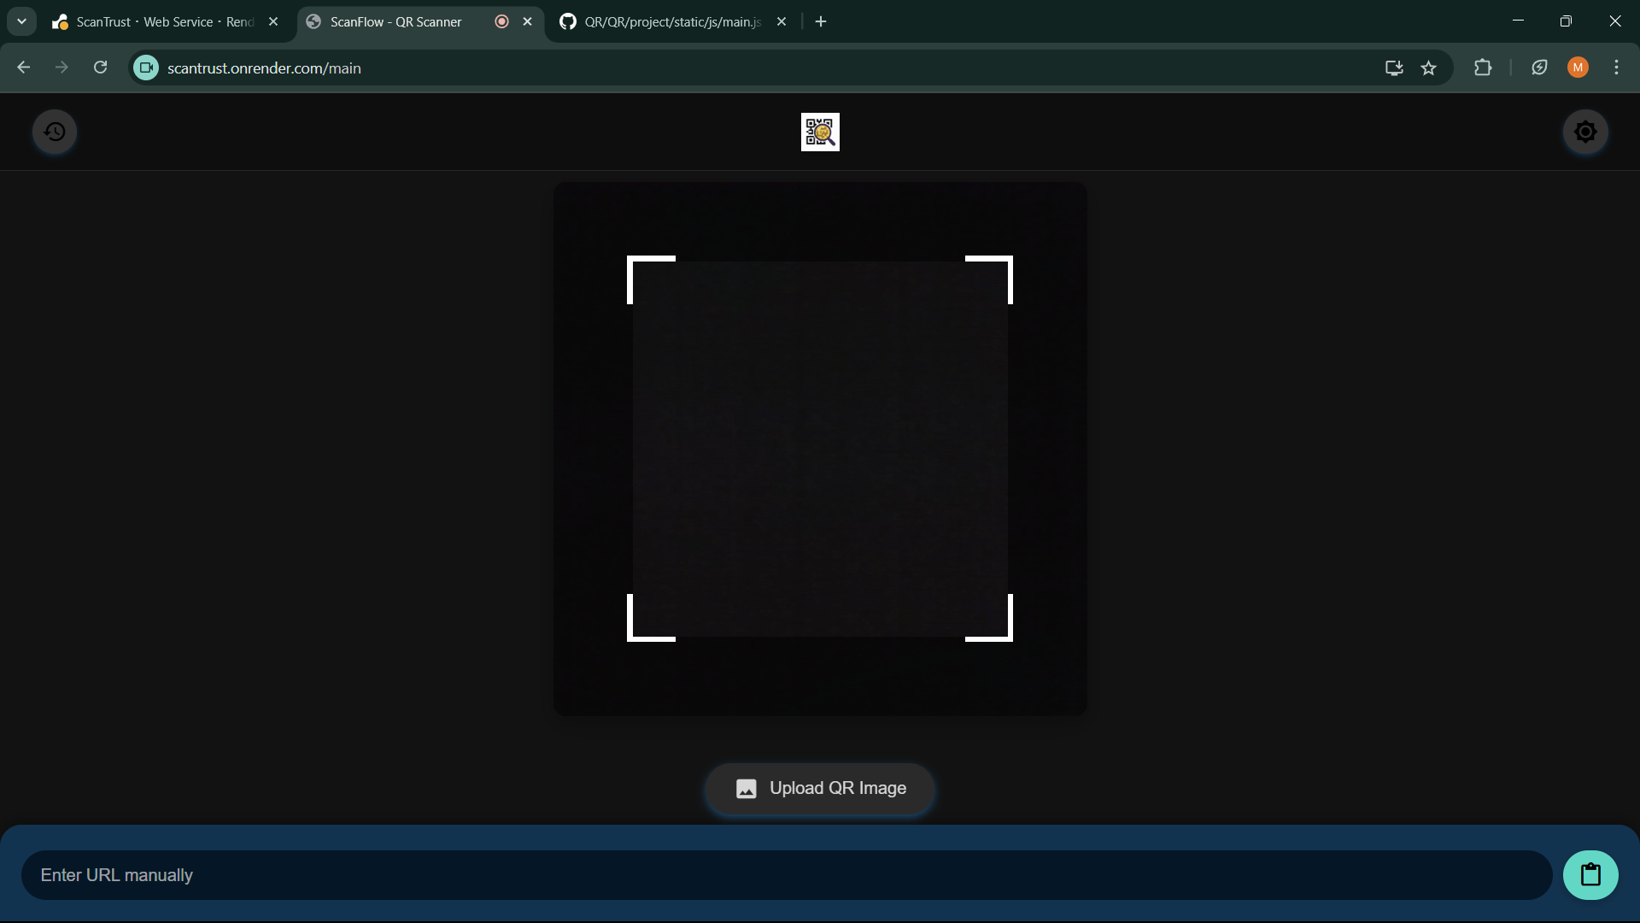

Slide 7
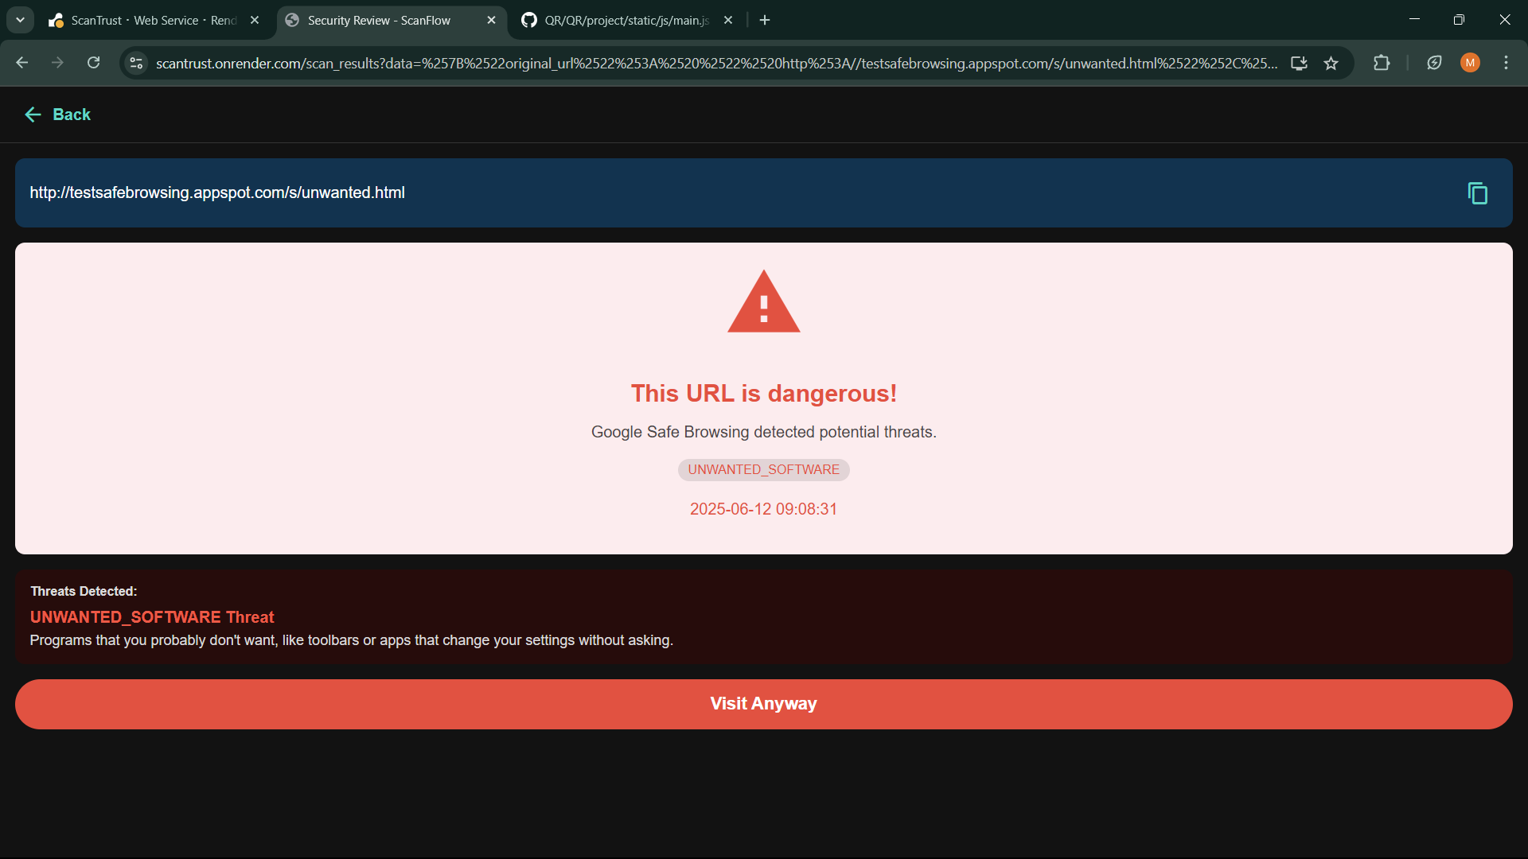

Slide 8
1. Main Screen
Purpose: Launch QR scanning or manual URL entry. Features:
"ScanFlow - QR Scanner": Tap to activate camera scanning.
"Upload QR Image": Select a QR code image from your gallery.
"Enter URL manually": Type/paste a URL directly. Navigation:
Back button (←) returns to previous screen.
2. Camera Scanning Mode
How to Use:
Point your rear camera at a QR code.
The app automatically detects and scans it.
On success: Shows URL safety check (see below).
Tips:
Ensure good lighting.
Hold steady for 2 seconds.

Slide 9
3. URL Safety Results
A. Safe URL (e.g., google.com)
Displays: ✅ "This URL is safe!"
Timestamp of check.
"Visit Website" button to proceed.
B. Dangerous URL (e.g., unwanted.html)
Displays: ⚠️ "This URL is dangerous!"
Threat type (e.g., "UNWANTED_SOFTWARE").
"Visit Anyway" button (use with caution).

Slide 10
4. Upload QR Image
Steps:
Tap "Upload QR Image".
Select an image from:
Gallery (Pictures/Downloads).
File explorer (Documents/Desktop).
App scans the image and shows URL results.
5. Manual URL Entry
Steps:
Tap "Enter URL manually".
Type or paste a URL.
Tap "Go" to check safety.

Slide 11
6. Navigation & Settings
Back Button (←): Returns to previous screen.
"My PVM": Likely a settings/account menu (UI not fully visible).
Website: scantrust.onrender.com

Slide 12
Key Notes for Users:
🔒 Safety First: The app checks URLs via Google Safe Browsing.
📷 Camera Tip: Uses rear camera by default.
⚠️ Warnings: Heed "dangerous URL" alerts.
Troubleshooting:
No Camera Access? Grant permissions in browser/PWA settings.
Scan Failed? Try uploading an image instead.

Slide 13
THANK YOU

